Slide 1

PYTHON PROJECT
MSE.TEAM1
1. Ngô Anh Tuấn
2. Nguyễn Mạnh Cường
3. Đinh Lưu Ly
SUPERVISOR
HUNGPD2
Notes:
NOTE:
To change the image on this slide, select the picture and delete it. Then click the Pictures icon in the placeholder to insert your own image.

Slide 2

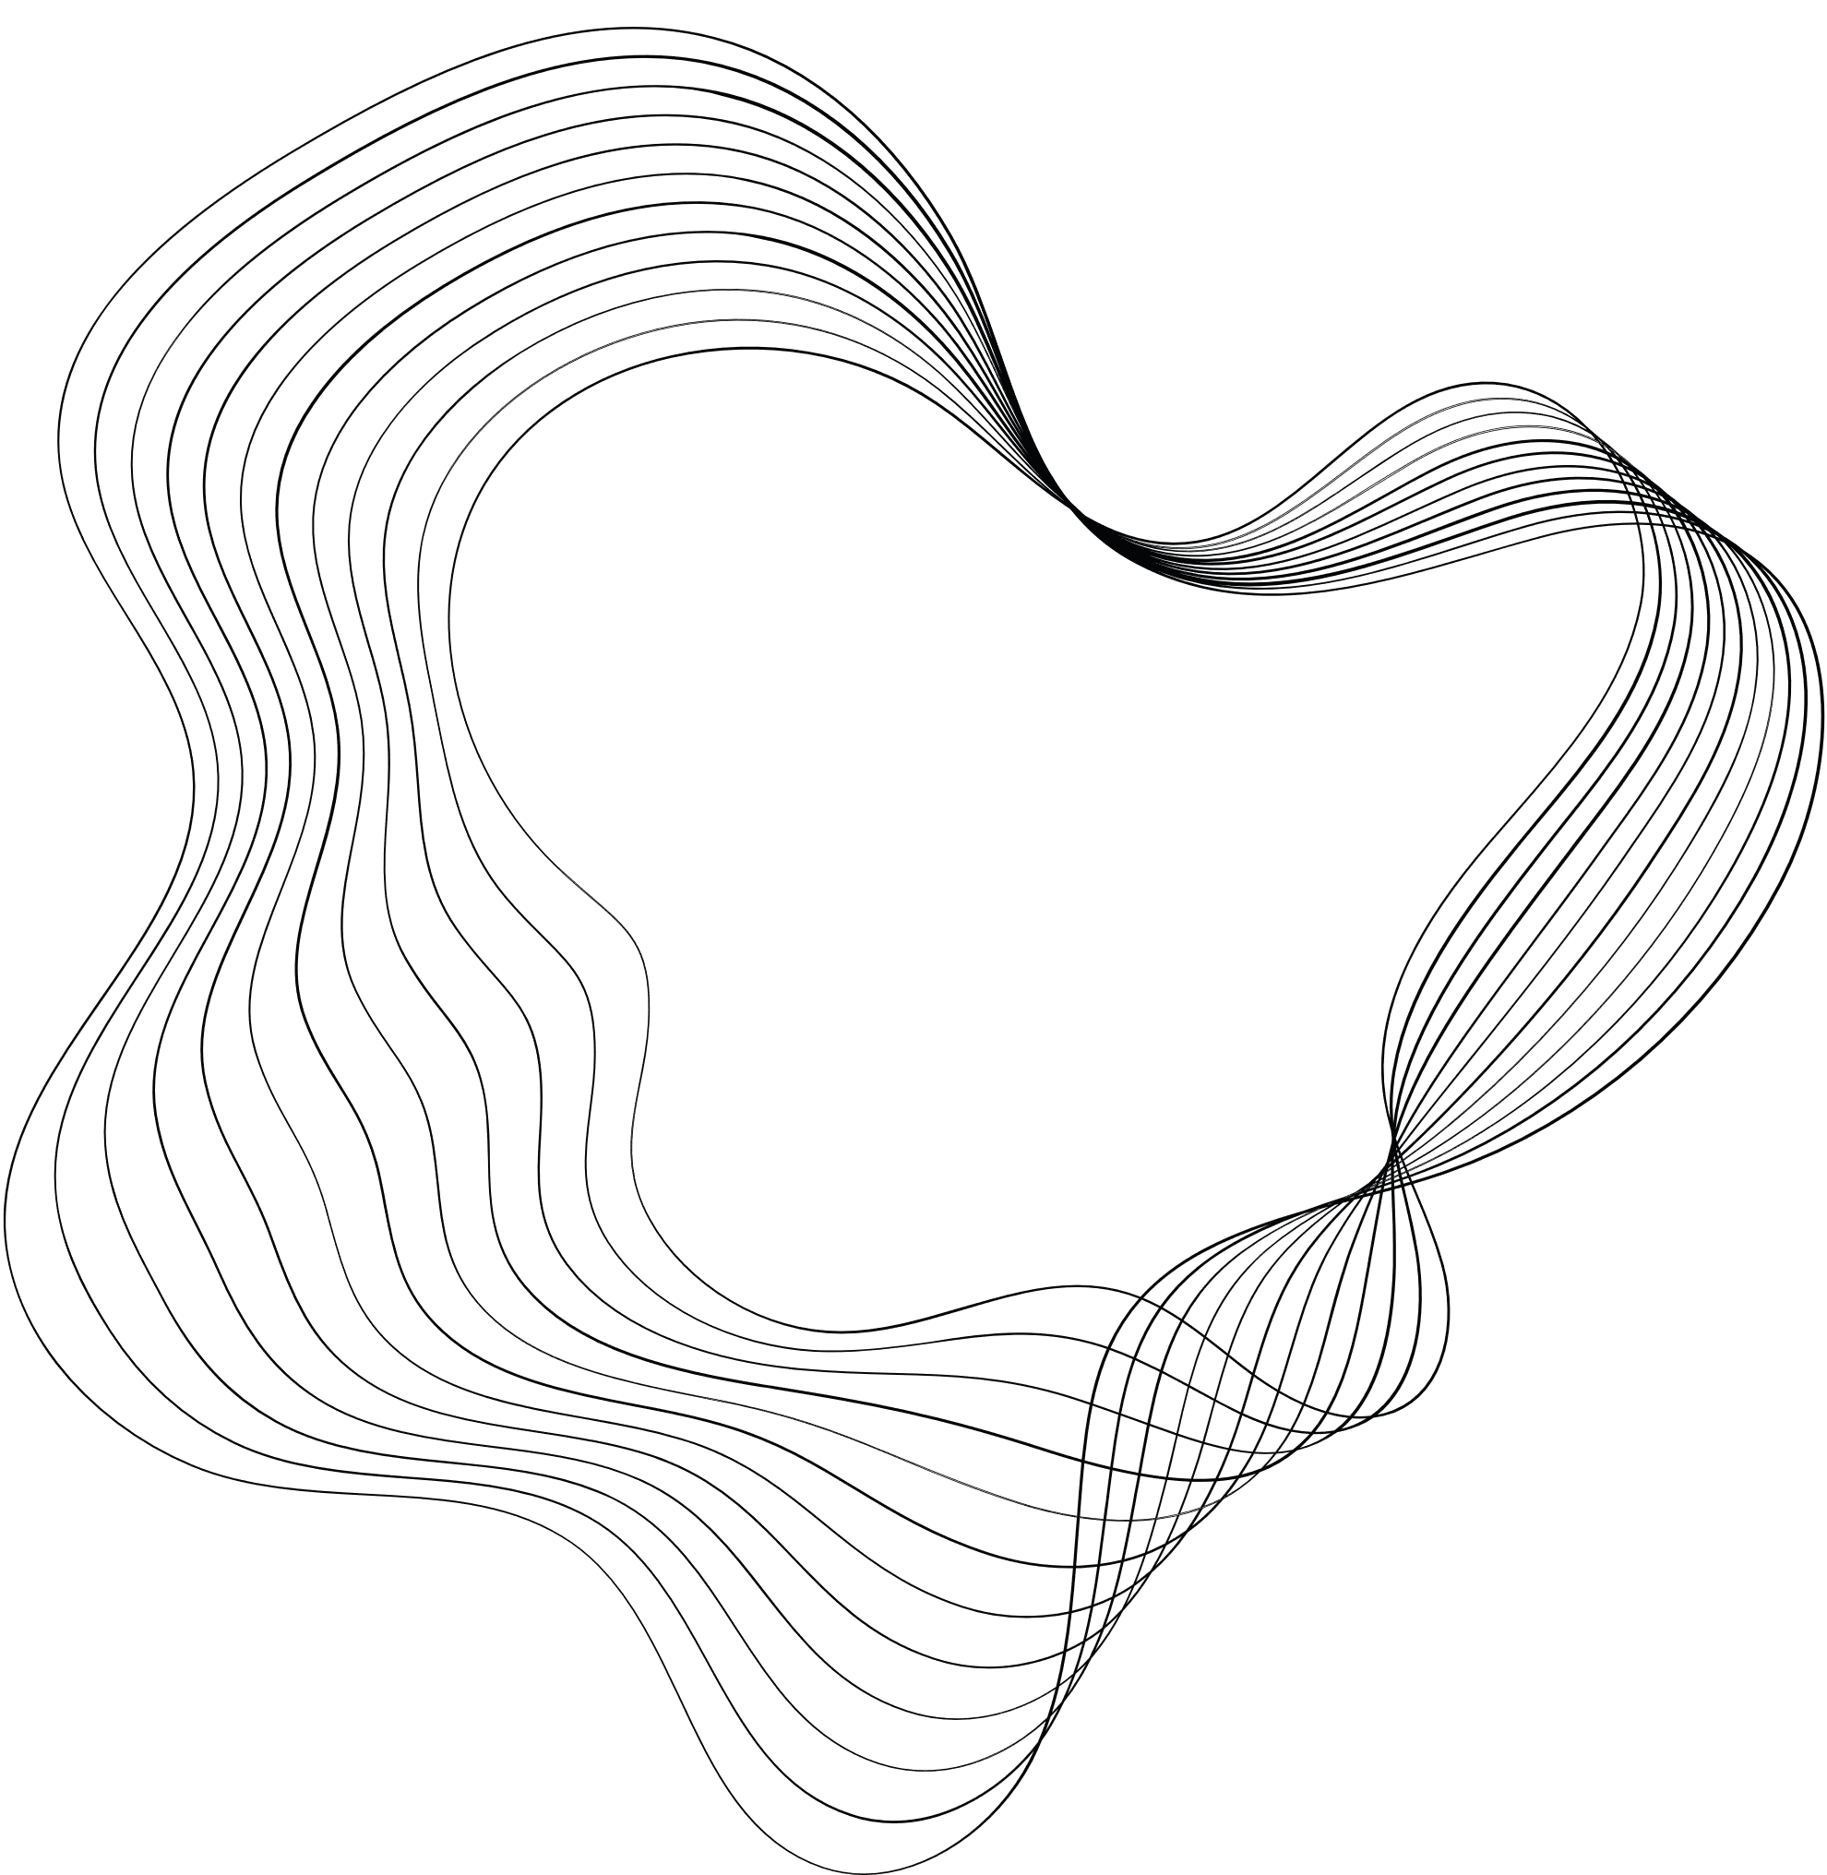
CONTENT
01
OUR TEAM
02
Project requirements
03
Tools/Language
04
Django web framework
05
Read docx template
06
DEMO
07
Q&A

Slide 3






1. OUR TEAM
Ngo Tuan
Nguyen Manh Cuong
Dinh Luu Ly

Slide 4

2.PROJECT REQUIREMENTS
Mission
Designing a system to create and manage exam banks and multiple-choice exam using Python & frameworks based on Python
- Exam importer: Use software to automatically import docx files into the database. The software has a few warnings such as checking for incorrect formatting, etc.
- The person who edits the exam bank: has the right to edit according to the assigned subject, the functions allow: viewing, adding, editing, and deleting each question directly.
- Exam creator: creates exam questions by subject, in which the answer order is randomly shuffled. Set parameters: exam code, exam time (duration), number of questions in 1 exam.
Requirements

Slide 5
3. TOOLS/ LANGUAGES
System requirement:Python, Mysql
Python library: Django, mysqlclient,python-docx(see requirement.txt)
MysqlDatabase: use database_dump.sql to create example database

Slide 6
3.1: System structure
Client: use web browser to login system
Webserver: deploy on premise server publish on internet, build with Django web framework
Database: build with MySQL technology

Slide 7
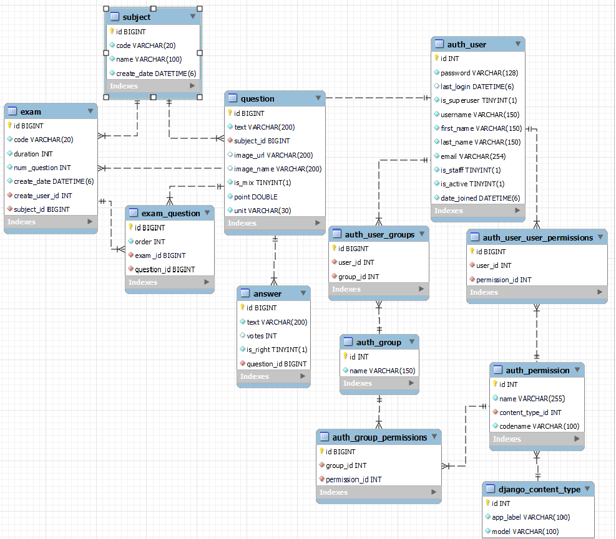
3.2 Database entity relationship diagram(ERD)

Slide 8
4: Whats is Django web framework
Homepage: https://www.djangoproject.com/
Django is MTV Architecture (Model template views)
MTV base on MVC, difference between
MVC | MTV | Detail
Model | Model | Database community
Views | Template | User interface
Controller | Views | Logic processing

Slide 9
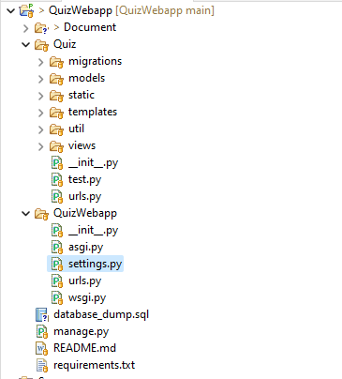
4.1 Django projects skeleton
Quizwebapps Team1 project
QuizWebapp: Django configuration folder
Quiz: Code folder of projects
Quiz/templates: html template file use render user interface
Quiz/views: python code use process business(read docx,
create subject, question, exam…)
Quiz/models: Django ORM Object (Object relational mapping)
Quiz/static: static file(image, js, css)

Slide 10
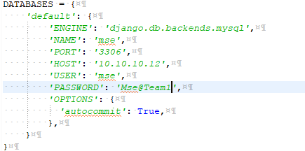
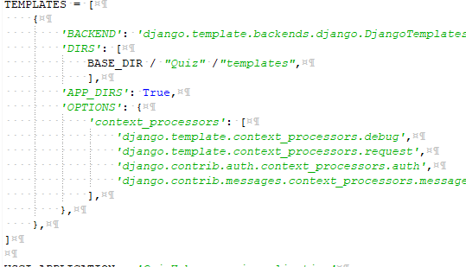
4.1 Django configuration
Django load config variables from python file QuizWebapps/settings.py
Database config
Template config

Slide 11
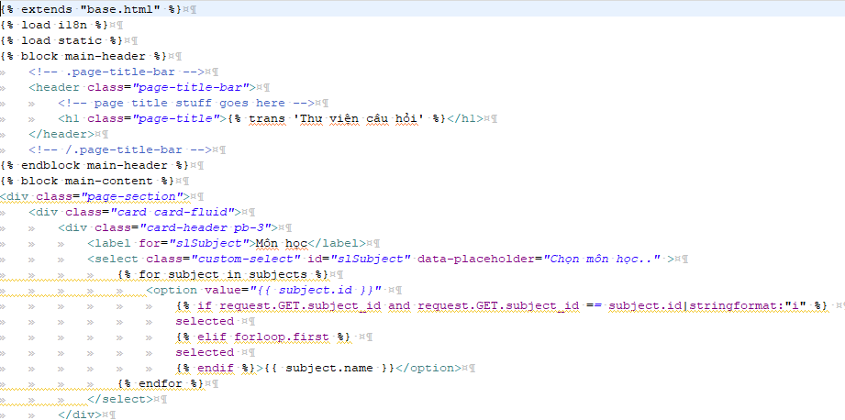
4.2 Django template
Django is rendered with a context. Rendering replaces variables with their values, which are looked up in the context, and executes tags
Examples
{% extends "base.html" %} : load template structure from other template. In base.html define Block to use
{% load i18n %}: load i18n variables to translate dictionary
{% load static%}: static variables use to load static file(html, js, css)
{% for subject in subjects %}: browse list Subject send from views class

Slide 12
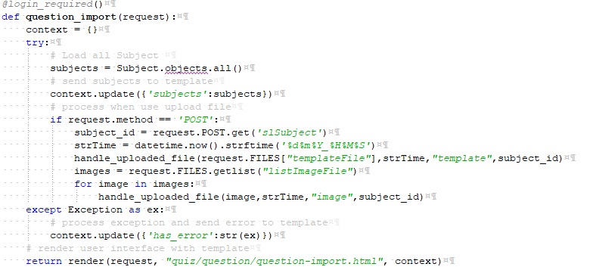
4.3 Django views
Views use to process business
Exam import question in Views/Question.py

Slide 13
4.4 Django models
Django ORM object
Example

Slide 14
5. Read docx template
To read docx file install python-docx with pip: pip install python-docx
def readDocx(file_name,subject_id,strTime):
questions = []
lines = list()
fname, file_extension = os.path.splitext(file_name)
if file_extension!= '.docx':
raise Exception("Sorry, incorrect file format")
doc = Document(file_name)
#đọc từng dòng văn bản
for paragraph in doc.paragraphs:
#lưu nội dung từng dòng thành 1 list
data = paragraph.text.split(':')
#lấy value để insert vào data
#xóa bỏ khoảng trắng trước dữ liệu
data_insert = ''.join(dt for dt in data[-1] if not dt.isspace())
lines.append(data_insert)
#đọc từng table câu hỏi
for table in doc.tables:
question_text = table.rows[0].cells[1].text
image_name = str(get_image_name(question_text))
image_name = 'upload/'+strTime+'/image/'+image_name.replace("['", '').replace("']", '').strip()
print(image_name)
#lấy ra nội dung câu hỏi
question = Question()
question.subject_id = subject_id
question.image_name = image_name
question.text = question_text
print('question: %s'%question_text)
#lấy ra mark
mark = table.rows[len(table.rows) - 3].cells[1].text
question.mark = float(mark)
#lấy ra unit
unit = table.rows[len(table.rows) - 2].cells[1].text
question.unit = unit
#lấy ra mix choices:
mix_choices = table.rows[len(table.rows) - 1].cells[1].text
if mix_choices=='Yes':
question.is_mix =True
else:
question.is_mix = False
#lấy ra đáp án
correct_answer = table.rows[len(table.rows) - 4].cells[1].text
#for i in range (1, len(table.rows) - 4):
#if table.rows[i].cell[0].text == correct_answer:
#answer = tab.rows[i].cell[1].text
question.save()
questions.append(question)

Slide 15
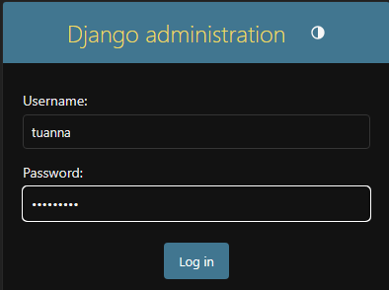
6: DEMO
Admin site http://localhost:8000/admin/login/?next=/admin/
Username: tuanna
Password: Abcd@1234

Slide 16
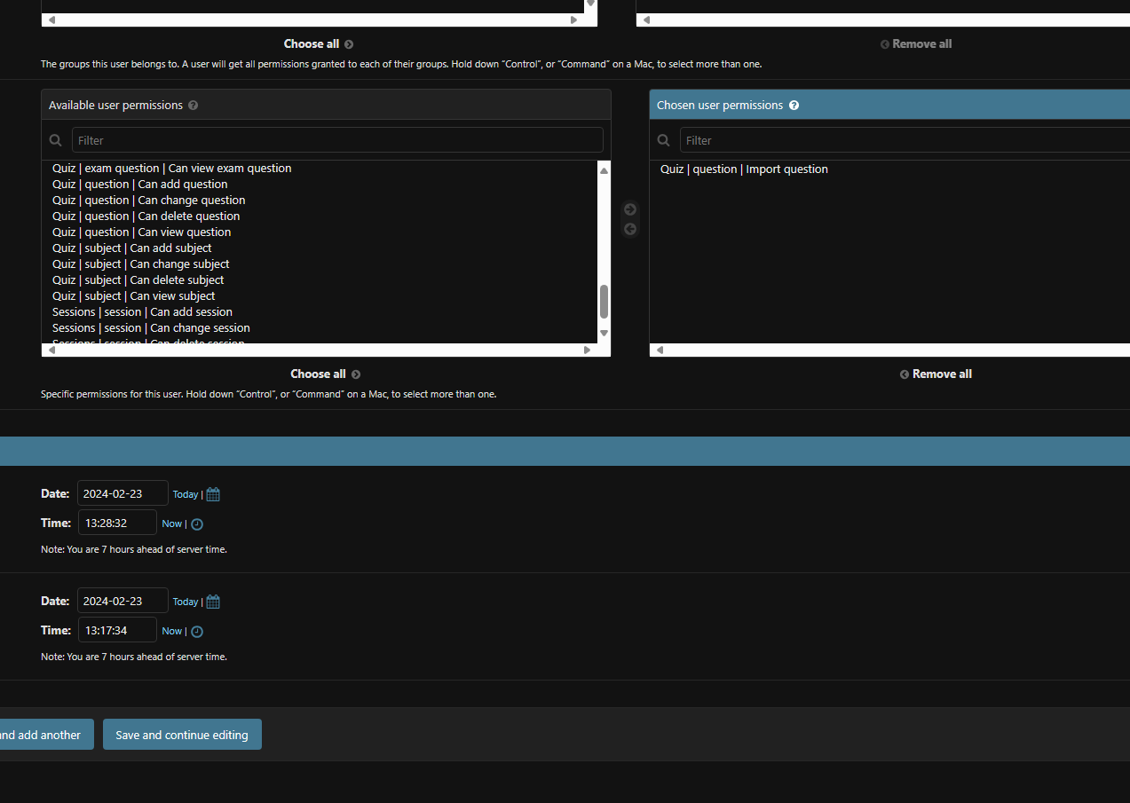
6.1.1 : Permission
Grant permission to user http://localhost:8000/admin/auth/user/2/change/

Slide 17
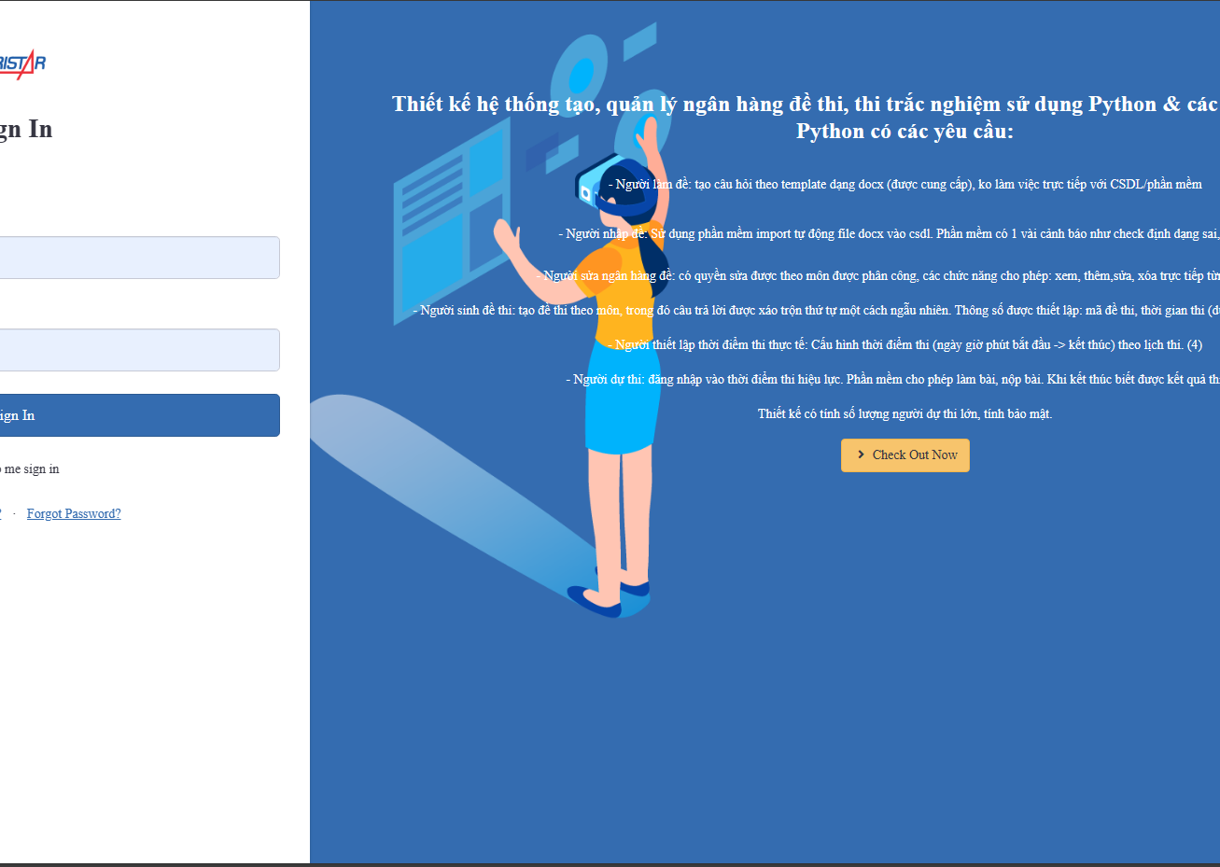
6.2: Quiz webapps site
Login http://localhost:8000/sign/in
tuan23mse13141@fsb.edu.vn
Abcd@1234

Slide 18
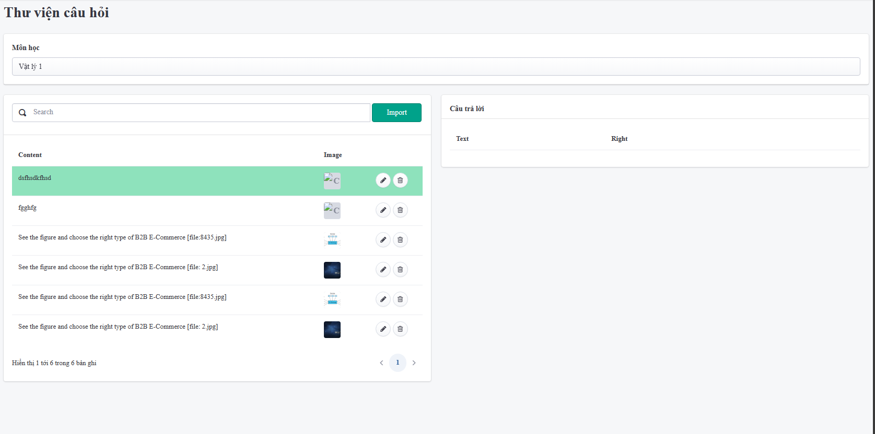
6.2.1 : Question
Question list: http://localhost:8000/question/

Slide 19
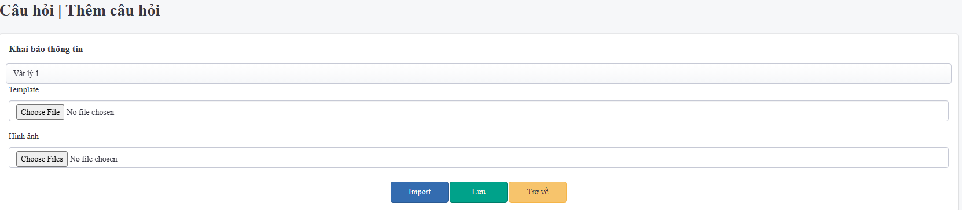
6.2.1 : Question
Question import : http://localhost:8000/question/import

Slide 20
Thank you
MSE.TEAM1

